Slide 1
PROJECT REVIEW
Webpage using
react and bootstrap libraries

Slide 2
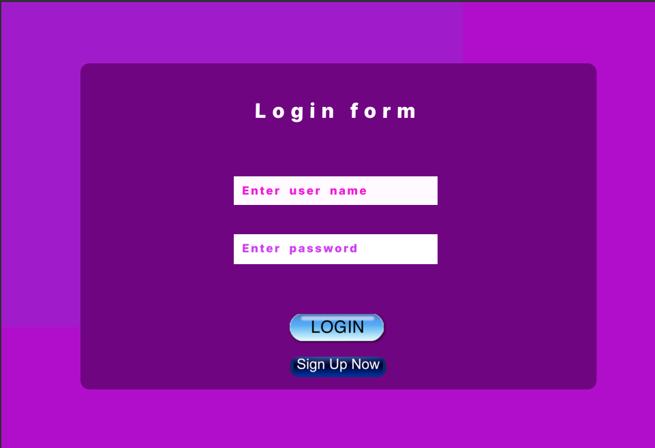
Enter the details to Login , If you have no account then use sign up to create new one.

Slide 3
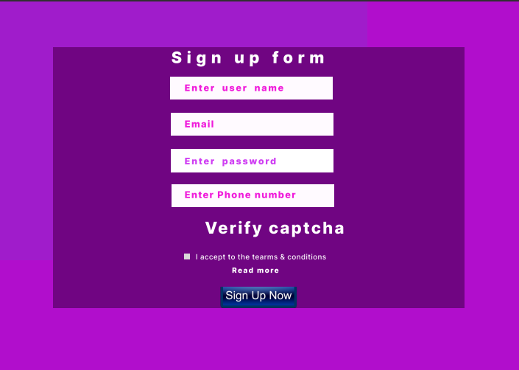
Enter the required details and click sign up so that it will take you to login page

Slide 4
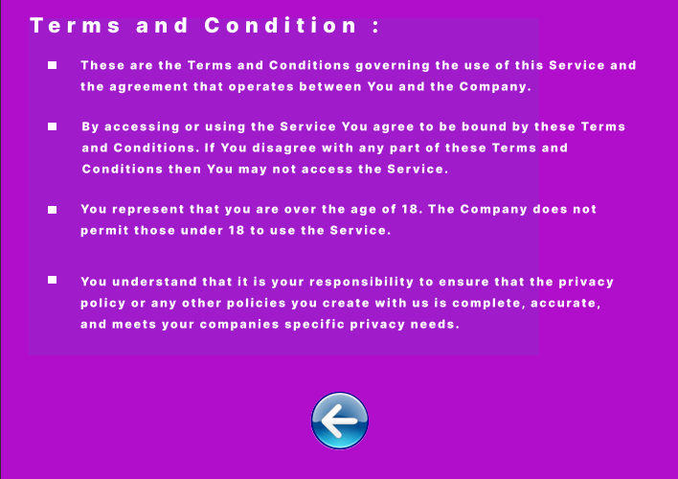
Now accept the terms and conditions

Slide 5
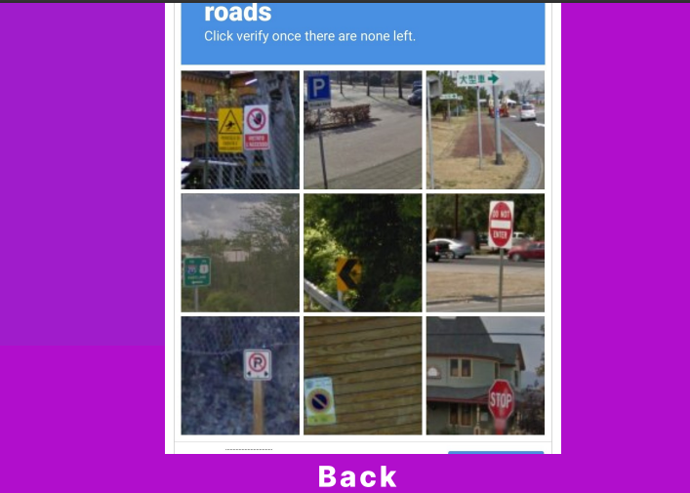
Verify captcha

Slide 6
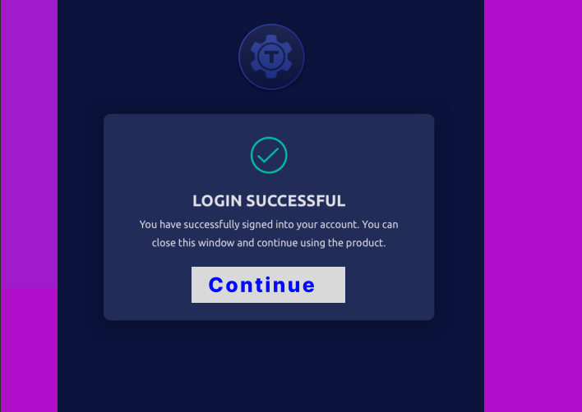
You have logged in successfully ,now click Continue

Slide 7
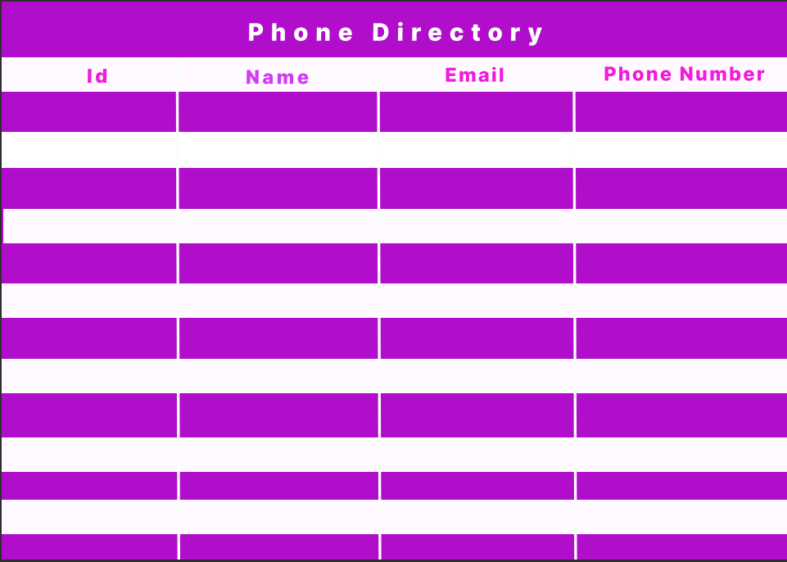
You will land on Phone directory page in which you can get required details.

Slide 8
Figma project link
https://www.figma.com/file/uTqCFa6cHV8NaTUiblYyBj/Untitled?node-id=0%3A3

Slide 9
Link for this ppt uploaded in github :
https://github.com/Jeeva-29/Phonedirectory/blob/main/PROJECT%20%20REVIEW.pptx

